Slide 1
Outliers and trimming
Emily li

Slide 2
abstract
Looked at outliers and effective ways in which to deal with them.
Compared data using robust statistics (winsorized mean, trimmed mean).
Looked at distribution of data, and how that affected trimming and subsequent data analysis results.

Slide 3
Problem: Outliers
Observations that lie at an abnormal distance from other values in a random sample from a population
Affects the variance, correlation, mean, and standard deviation, etc.
For instance, if there is a dataset with a strong pattern, a few outliers can make it difficult to find this pattern.

Slide 4
So what do we do with outliers?
If they affect results and assumption, it may need to be dropped.
However, the presence of the outlier should still be mentioned.

Slide 5
Trimming and winsor trim
Trimmed mean takes extreme values out. 10% trimmed mean removes top and bottom 10%, leaving the remaining 80%.
Winsorized mean sets the extreme values to equal to the next largest/smallest value.
Thus, winsorized mean is a robust estimator because it is less sensitive to outliers, but will still give a good estimate.
Problem with trimming: if the model distribution is not symmetrical.

Slide 6
Materials and methods: How did I solve?
Used epilepsy dataset from faraway package, by Julian Faraway
Dataset was collected from a clinical trial of 59 epileptics
Used psych package to calculate winsorized means, used trim function to calculate trimmed means.

Slide 7
Looking at the data
Epilepsy had the 6 following variables:
Seizures: number of seizures
Id: identifying number
Treat: 1=treated, 0=not
Expind: 0=baseline period, 1=treatment period
Timeadj: weeks of period
Age: in years

Slide 8
Looking at the data, cont.
Since treat and expind were both dummy variables, and, since time adjusted was also essentially a dummy variable, with only values of 2 or 8, I decided to focus mostly on the variables seizures and age to look at outliers.

Slide 9
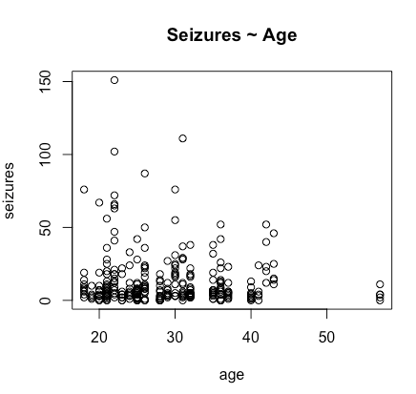
Simple plot of age against epilepsy
This found that there were a few outliers, with one major outlier at 151 seizures. There were also a handful of patients at age 57.

Slide 10
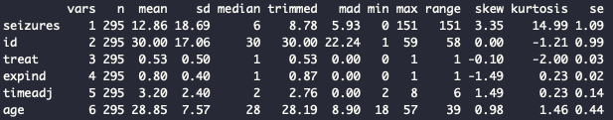
Using describe function on epilepsy

Slide 11
Should I exclude?
In order to decide whether to exclude or not, I looked at the mean and median of seizures and age.
Seizures mean: 12.86, median: 6
Age mean: 28.85, median: 28
Based on this, I decided to exclude the outliers for seizures, but not for age.

Slide 12
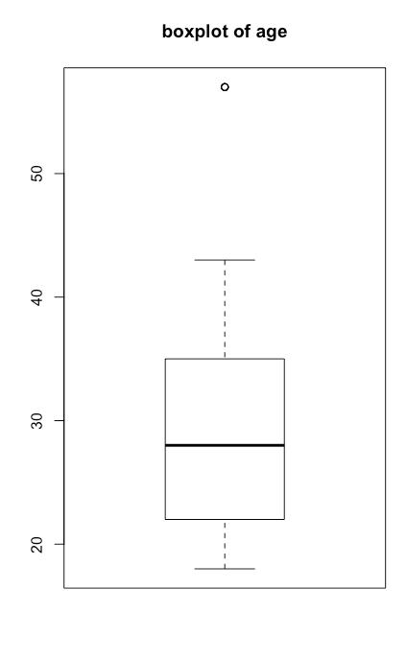
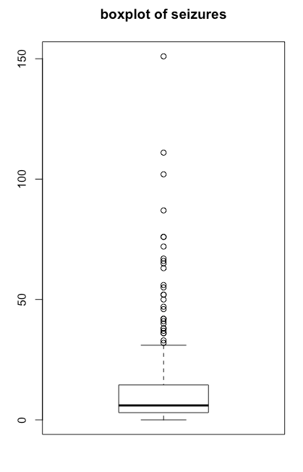

Slide 13
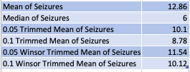

Results: what did I find?
Trimming the mean for the variable seizure shows a variety of results. I also checked how trimming the mean for the variable age, and found that it was quite unneeded.

Slide 14
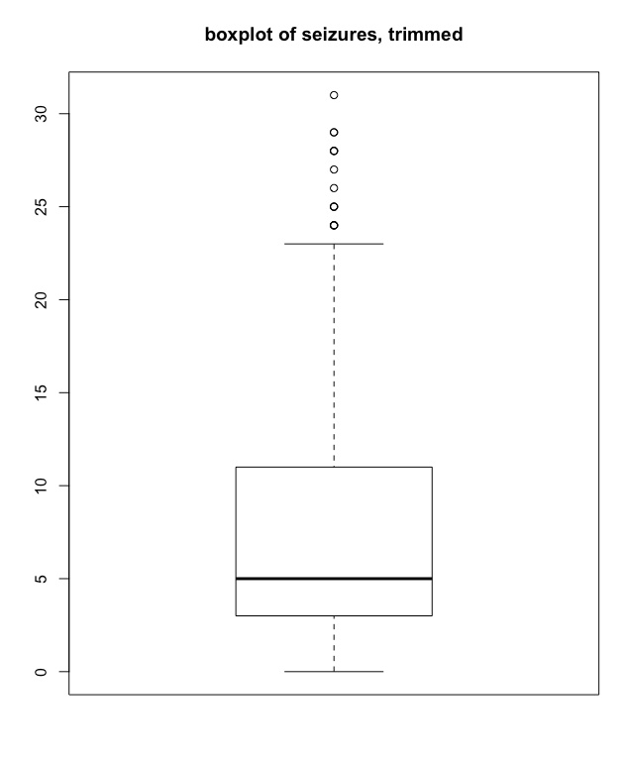
Results
After trimming the outliers using boxplot, we have the following resulting boxplot for the variable seizures. As we can see, the number of seizures has been trimmed greatly.

Slide 15
Discussion: what does it mean?
It makes sense and seems necessary to trim the data slightly to get rid of outliers. We get a better sense of the dataset epilepsy this way.
While in many cases outliers should be carefully studied, in this dataset, it would make sense to separate the extreme outliers in order to carefully study both the outliers by themselves, and the overall pattern that emerges from the data overall.
It’s also possible that we may have trimmed too much, and need to reevaluate in order to build a proper model.

Slide 16
Literature Cited:
Thall, P. F. and S. C. Vail (1990). Some covariance models for longitudinal count data with overdispersion. Biometrics 46, 657-671
Syed Abdul Hadi (2020). How to Remove Outliers in R. ProgrammingR.

